Slide 1
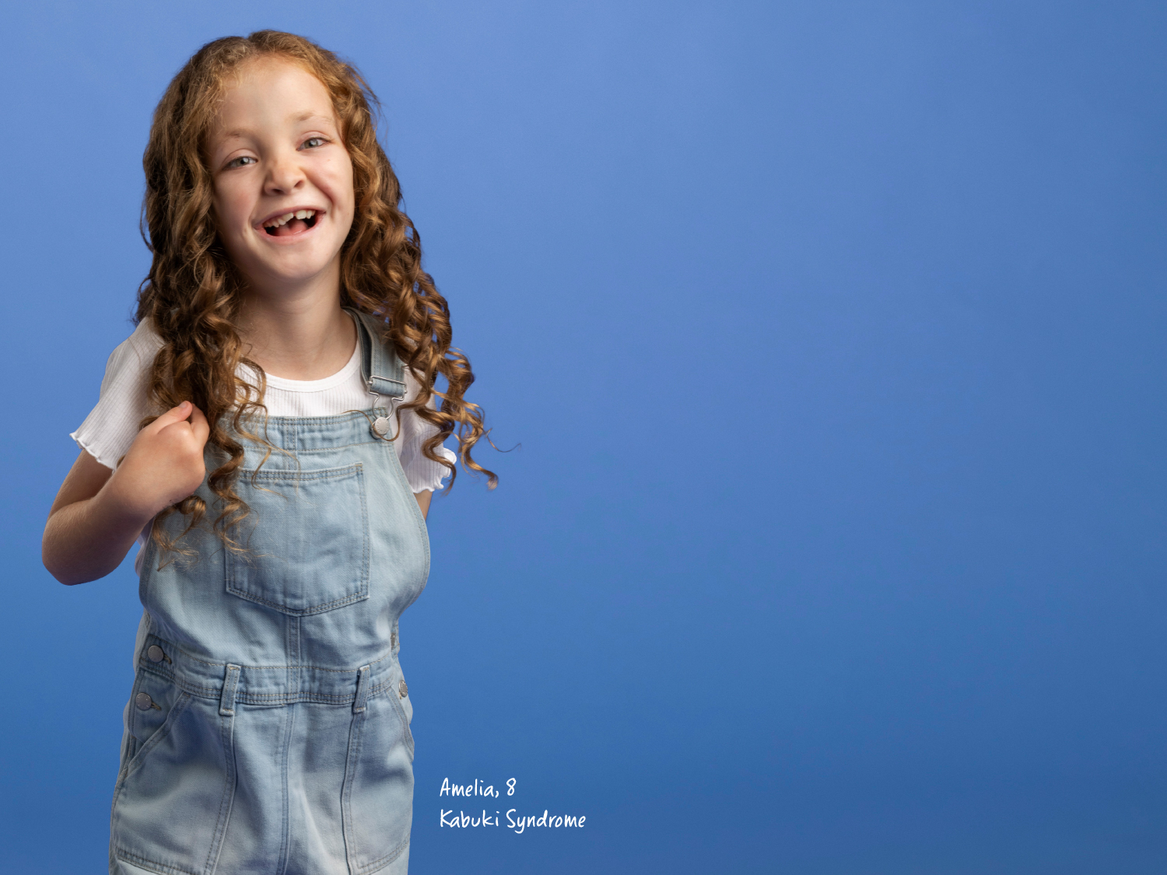

Jeans for Genes
K-6 Presentation

Slide 2

What are ‘genes’?
And why are they important?

Slide 3
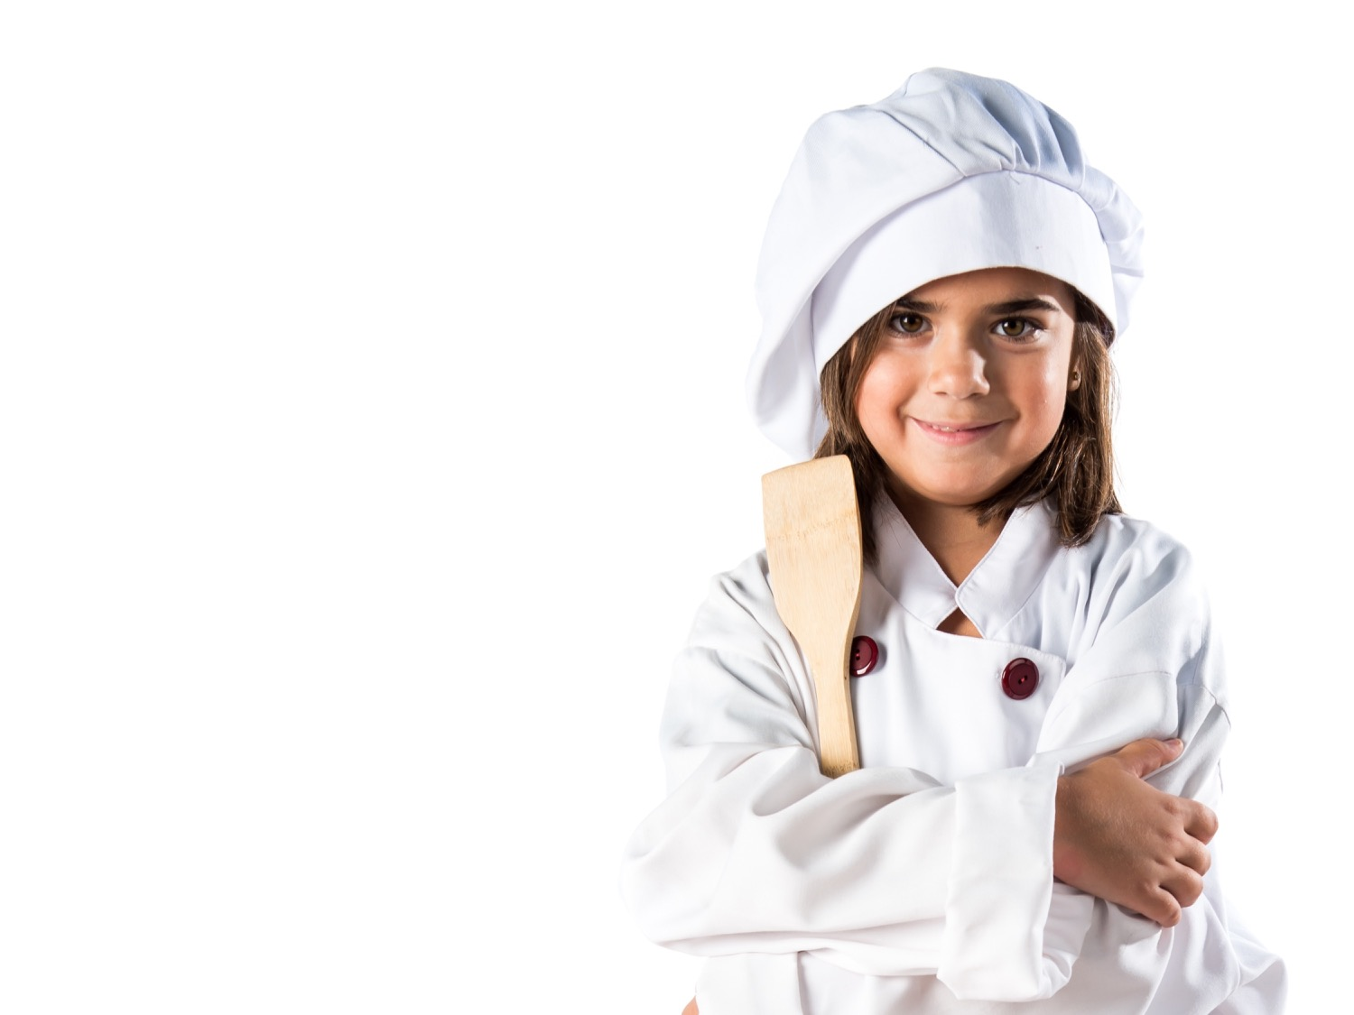
Genes are a recipe for making us!

Slide 4
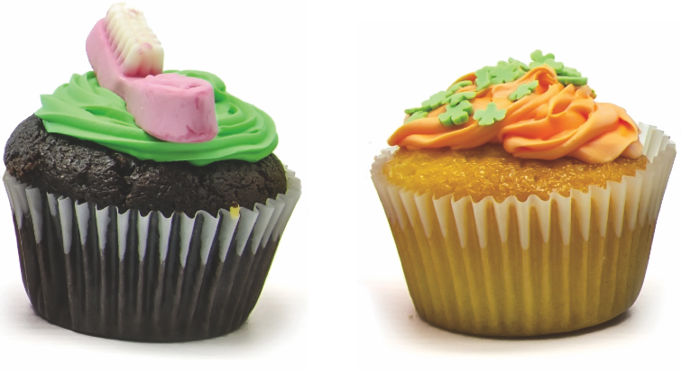
These two cupcakes are similar but slightly different.
Can you see the differences?
They’re different because their recipe is different.

Slide 5
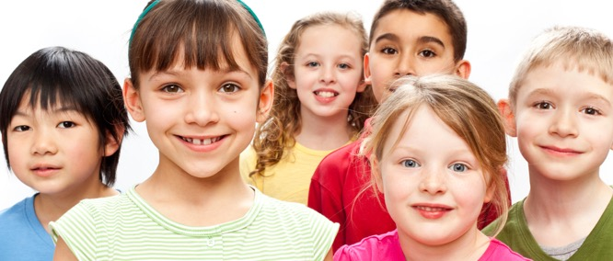
We’re all very similar – but we’re also unique! What are your little differences?

Slide 6
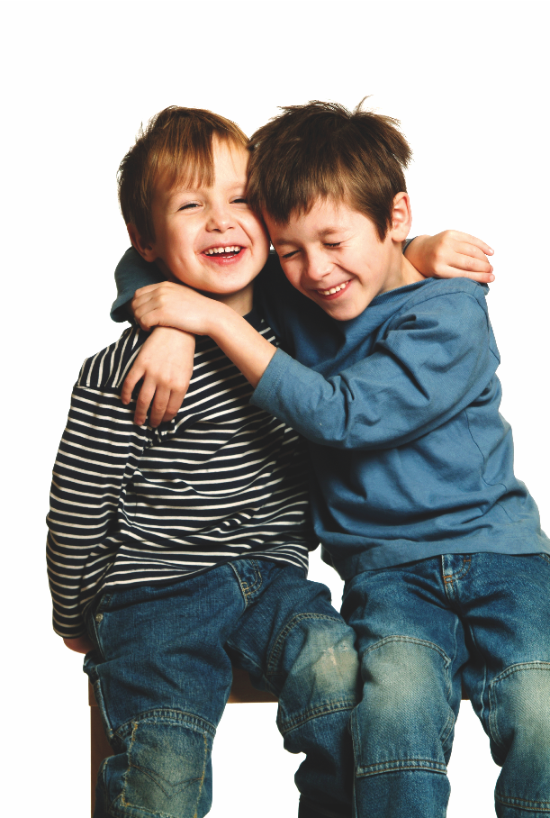
What you look like depends on your recipe…
Your GENES!

Slide 7
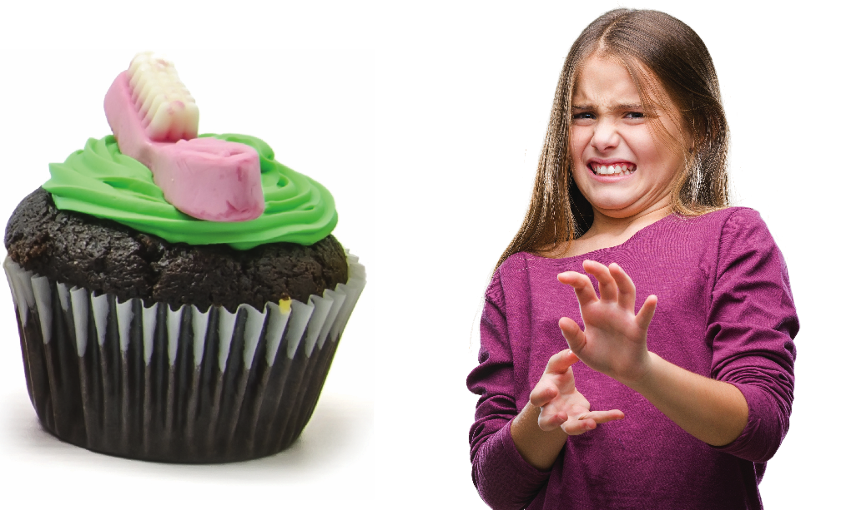
What if the cupcake recipe was wrong & we put salt instead of sugar in our cupcakes?

Slide 8
Our bodies are the same.
If our gene recipe changes, sometimes our bodies can become unwell.

Slide 9
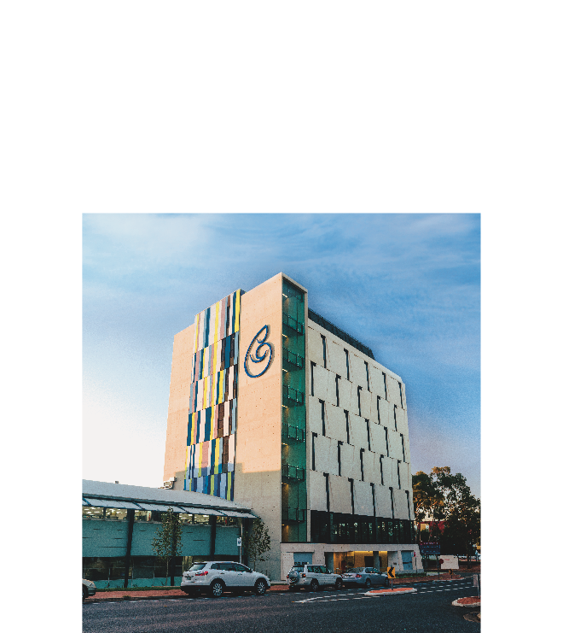
This is why
Children’s Medical Research Institute exists
We do research to understand:
  genes,
  what can go wrong with them,
  and how to fix it!

Slide 10
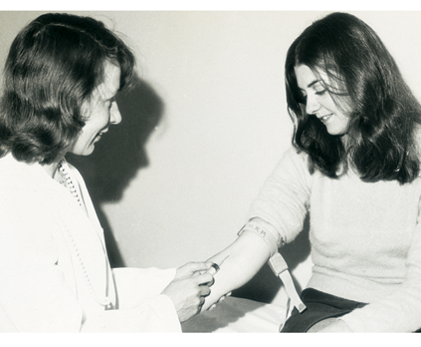
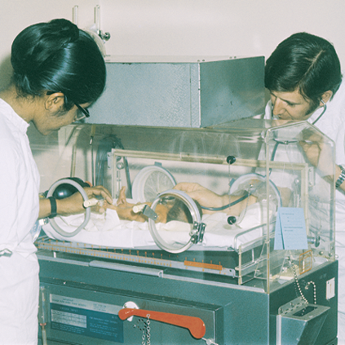
Children’s Medical Research Institute
Children’s Medical Research Institute is 60 years old!
Our scientists created the rubella vaccine to prevent birth defects
They even invented incubators to help babies born too soon!

Slide 11
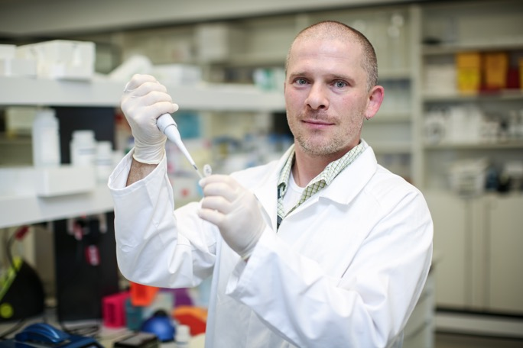
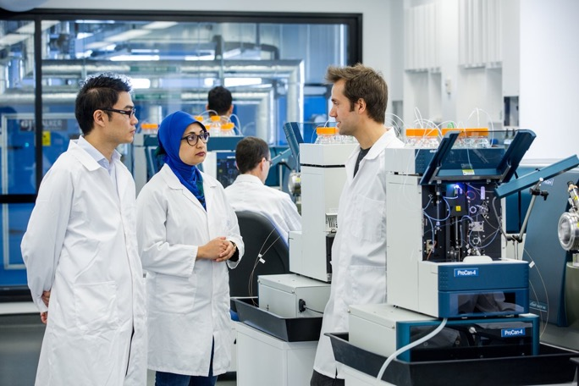
Children’s Medical Research Institute
Nowadays our scientists are finding cures for children’s genetic diseases - like cancer and cystic fibrosis.

Slide 12
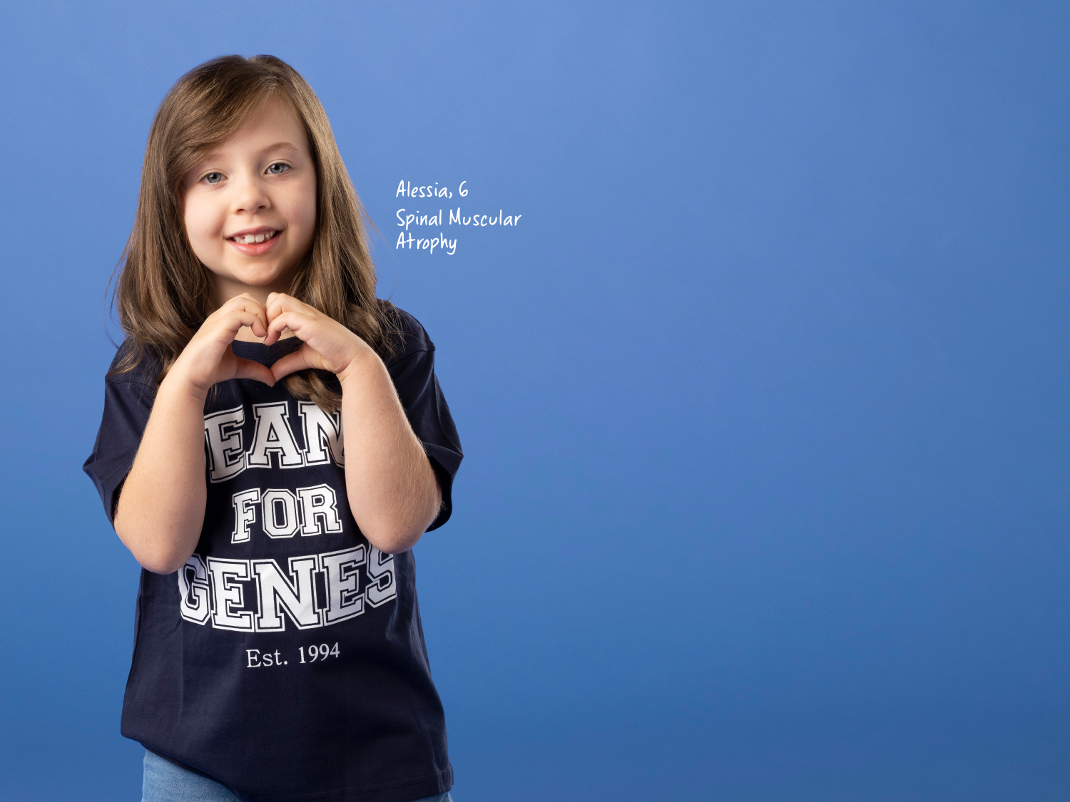
This is Alessia. She is 6.
She was born with a genetic disease which children died from only years ago. Now, thanks to a one-off injection of gene therapy, she’s living a full life.

Slide 13
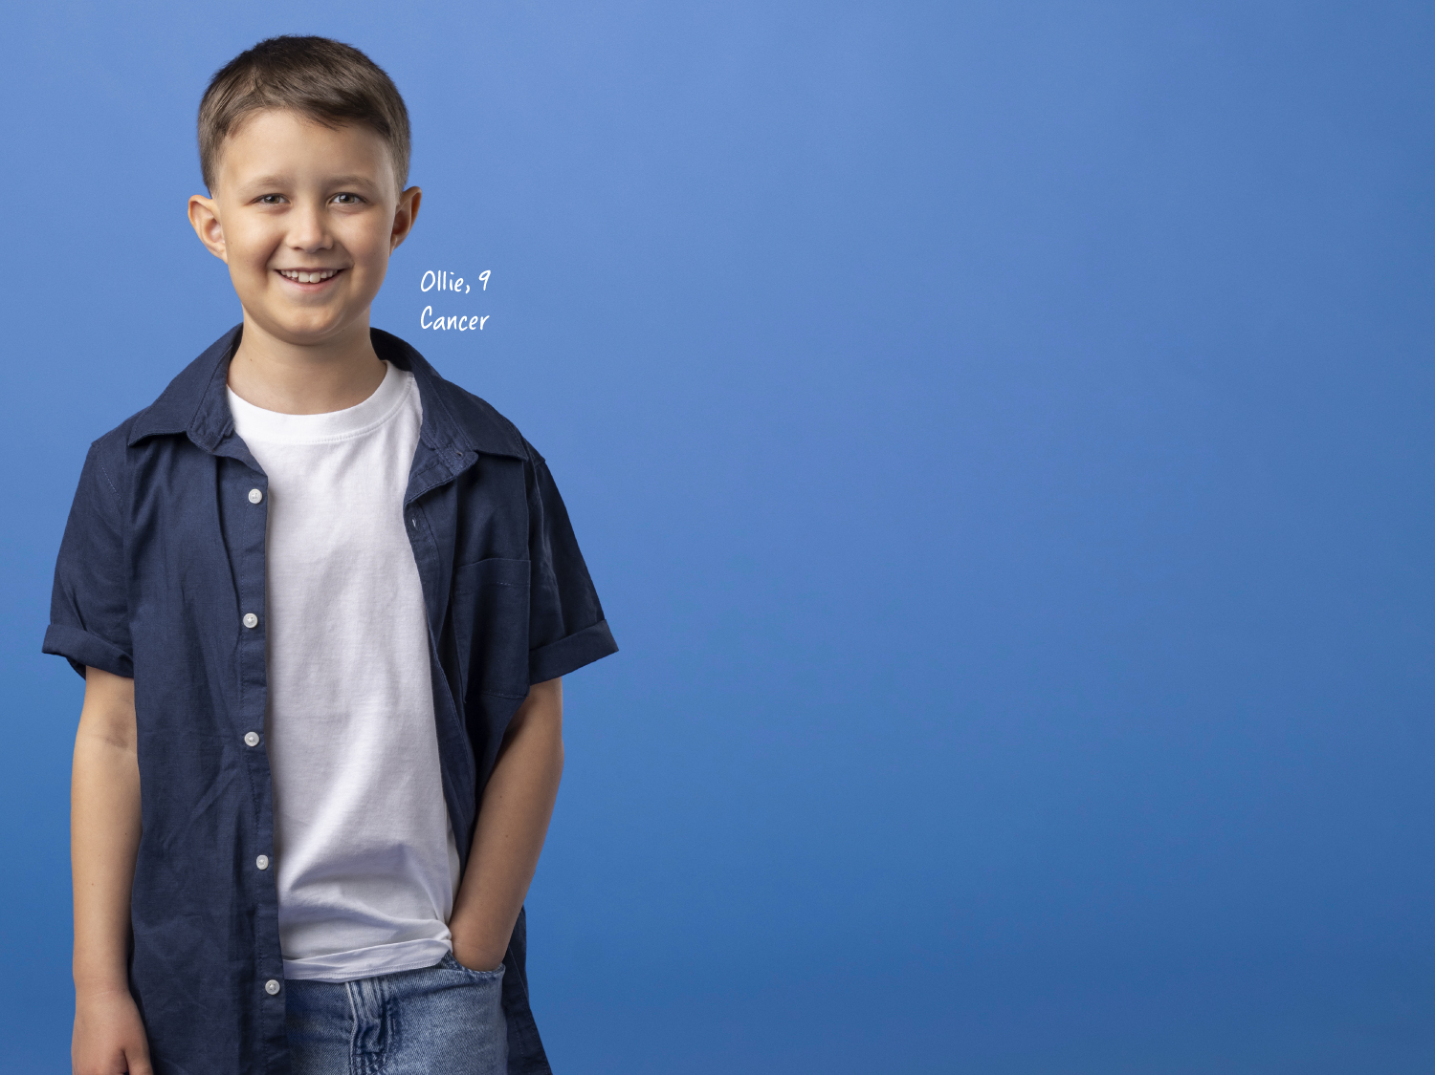
This is Ollie. He is 9.
He experienced dizziness and headaches before being diagnosed with cancer. It was research that helped doctors to choose the right treatment and now he’s in remission.

Slide 14
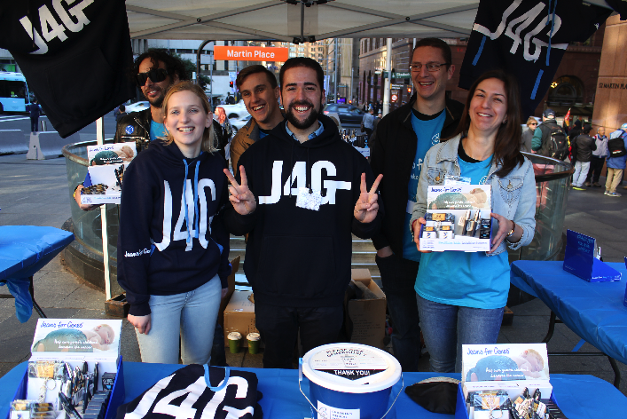
What does Jeans for Genes do?
Jeans for Genes Day was created to help Children’s Medical Research Institute raise money to find new treatments and cures for kids like Alessia, Sophia, Jett, Amelia and Ollie.
We believe all kids should have a chance to just be kids!
Here are some of our scientists who are working on cures when not raising money

Slide 15
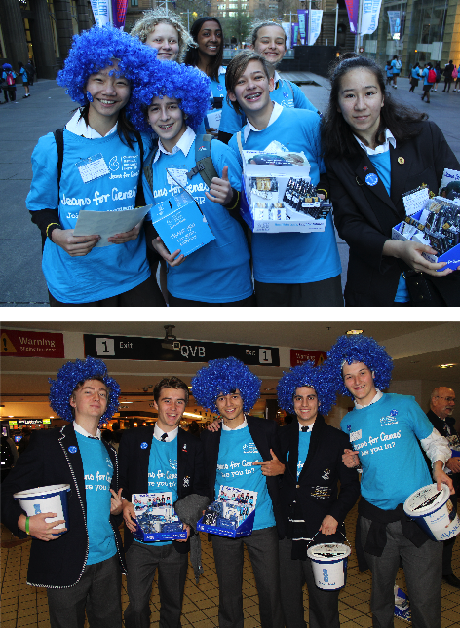
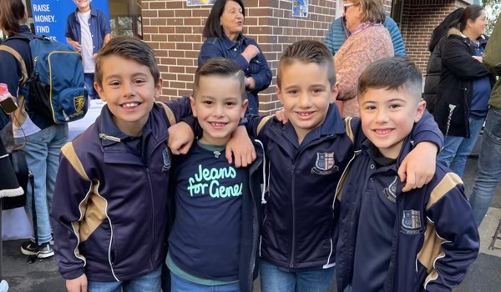
What you & your school can do to help
Sign up at jeansforgenes.org.au
Host a fundraiser - denim mufti day, movie night, Bake it Blue stall or your own fun idea.
Get involved anytime – it doesn't have to be August!
Donate funds to help our researchers find lifesaving treatments & cures.
Share your photos – we love seeing students learning about genes and helping seriously sick kids.
Thank you!

