Slide 1

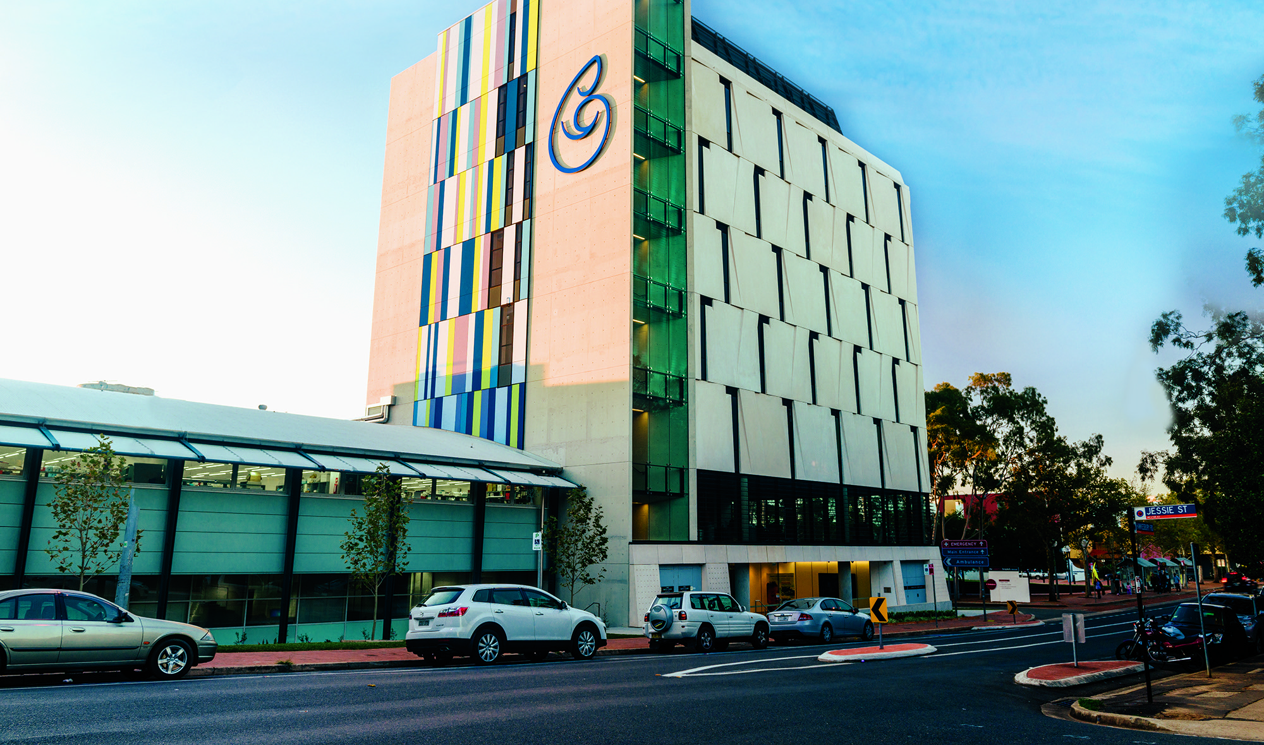


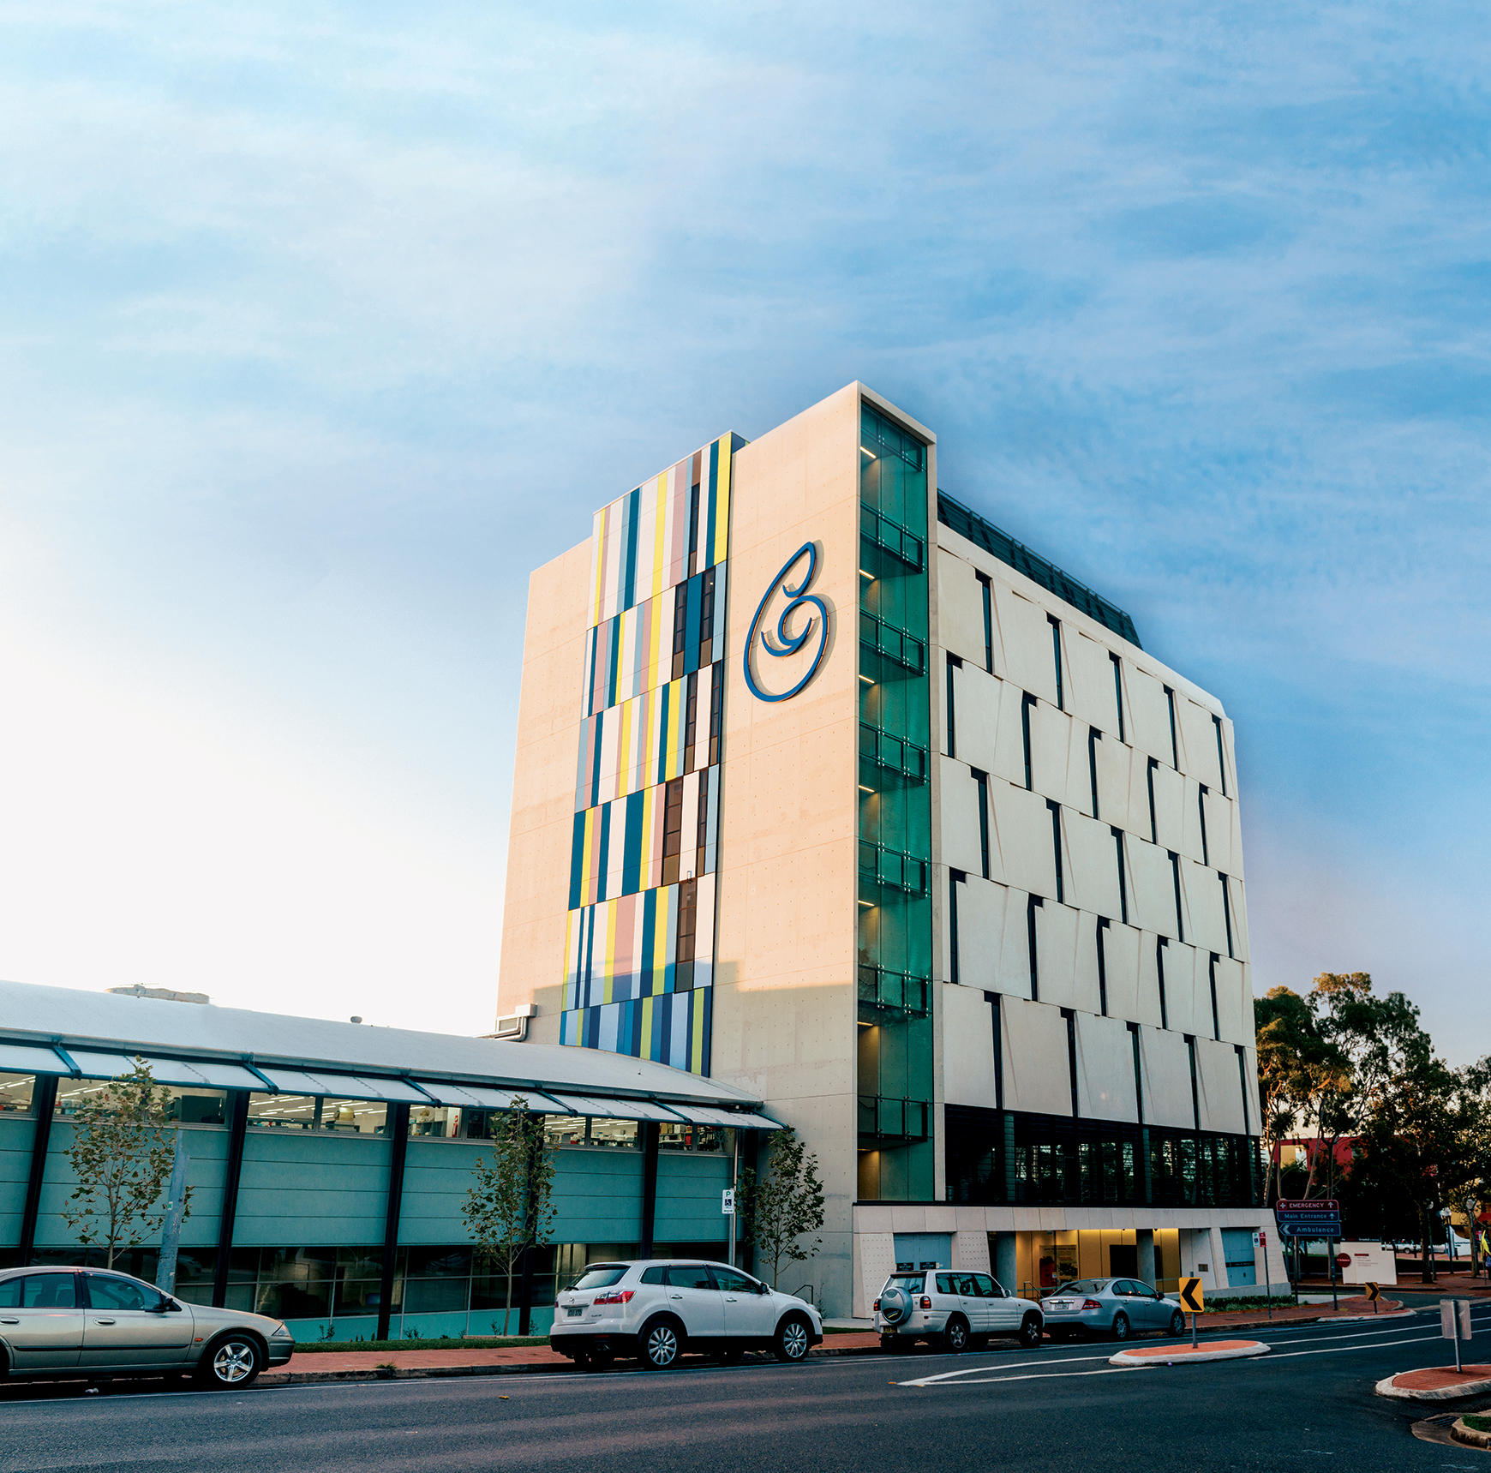
YouTube Video
- Tour of CMRI
Play in Slide Show mode

Slide 2
