Slide 1
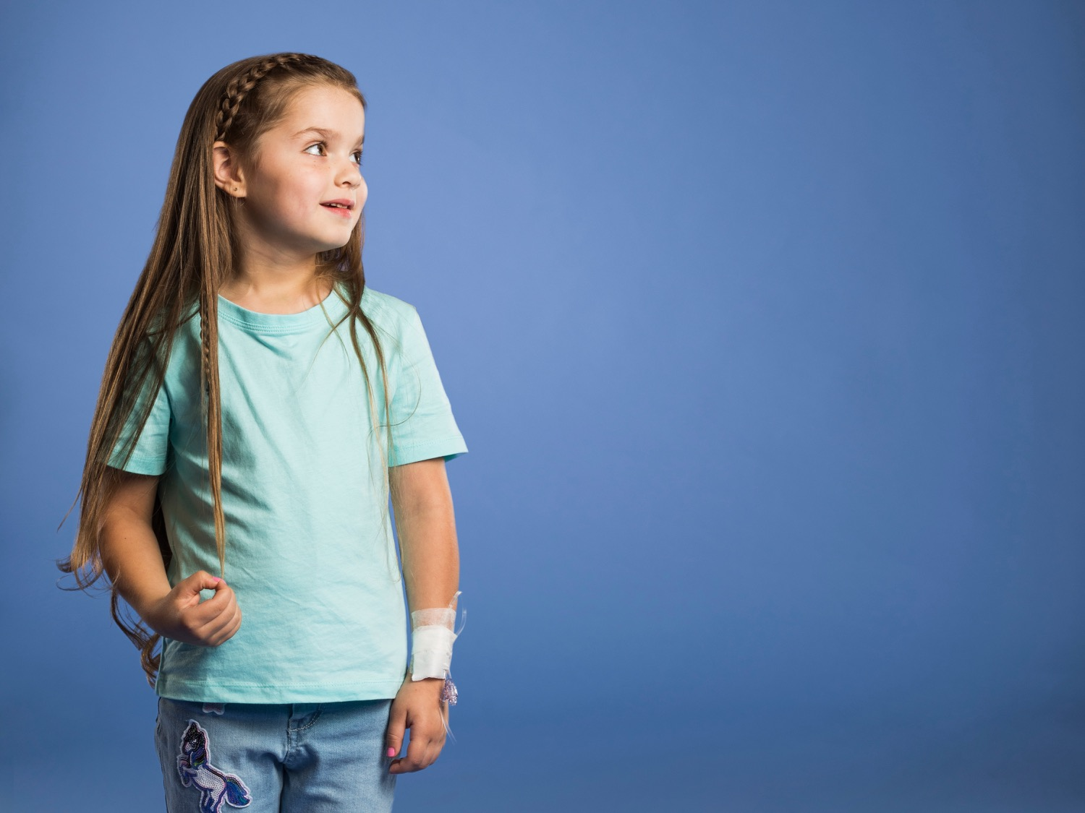

Jeans for Genes
High School Presentation

Slide 2
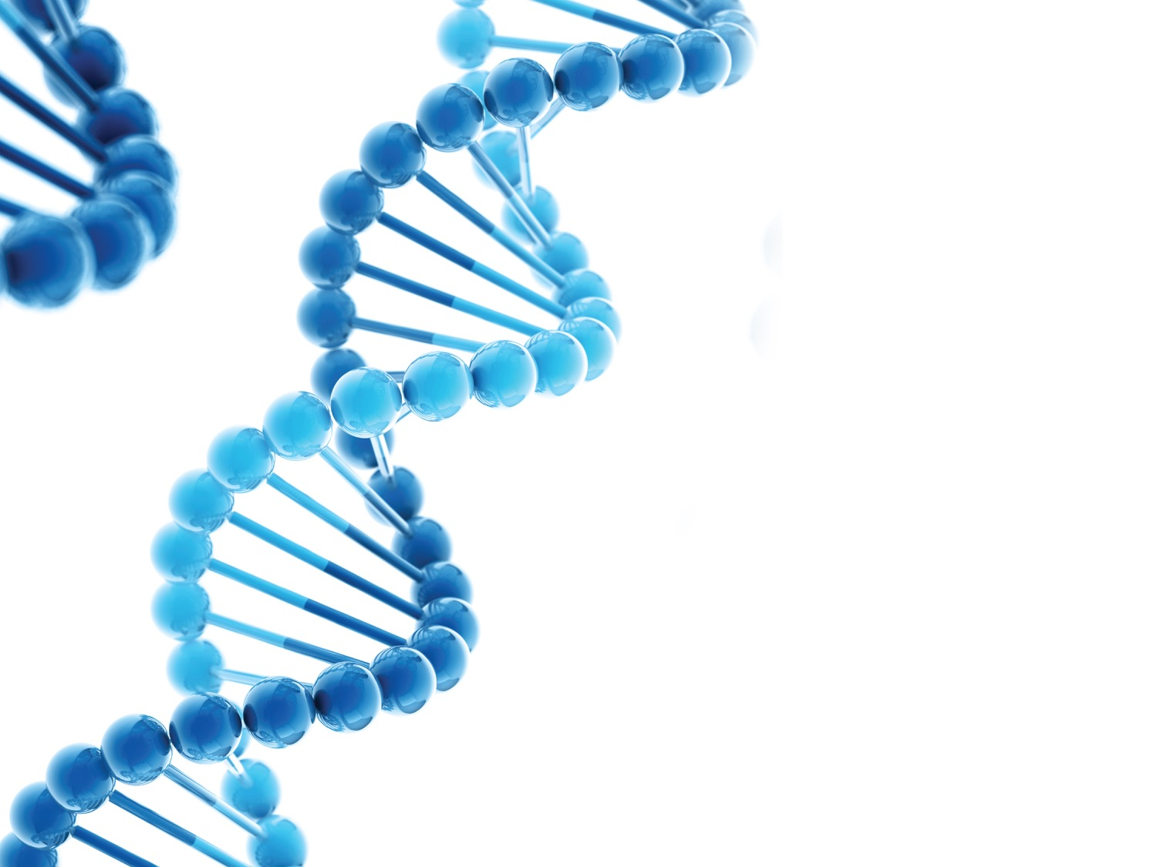
What are ‘genes’?
And why are they important?

Slide 3
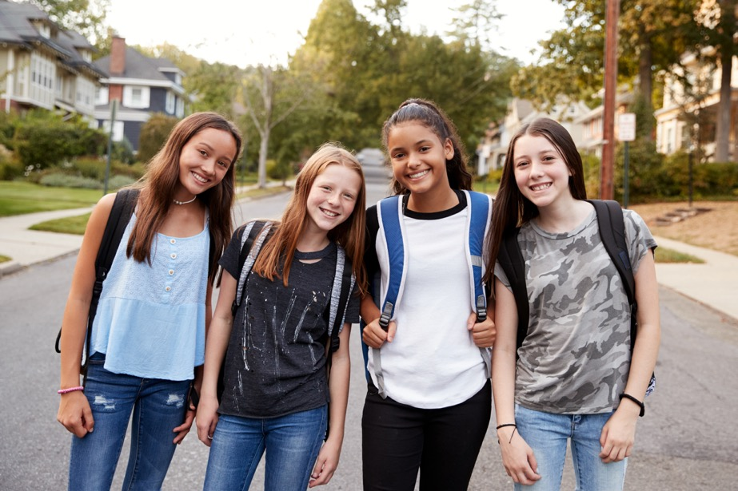
Genes ≠ Jeans!
Genes for hair colour
Genes for eye colour
Genes for dimples and how you smile
Genes are the recipes for making you!
It takes 20,000 genes to make you

Slide 4
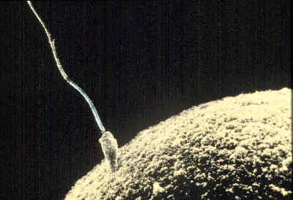
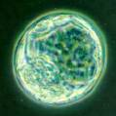
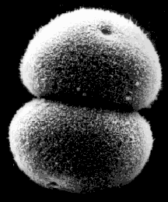
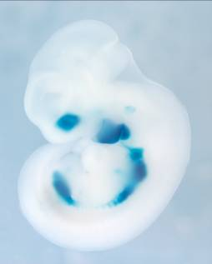
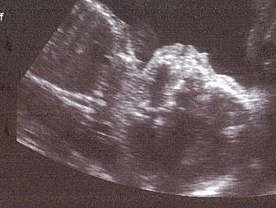
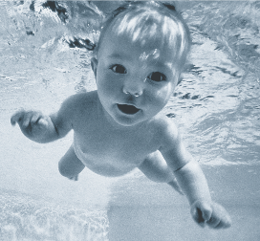
We all begin as 1 cell that replicates into many

Slide 5
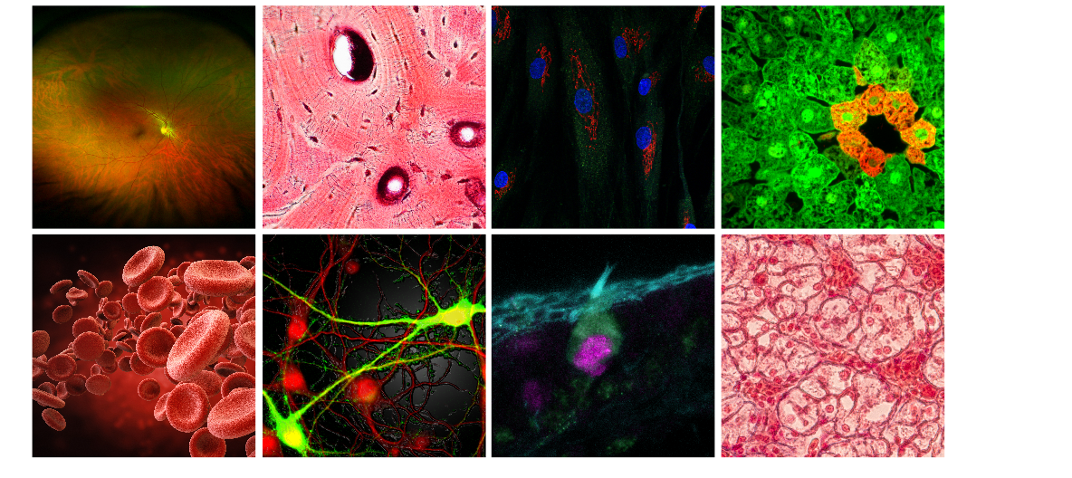
Each different type of cell has a purpose
eye
bone
muscle
liver
blood
brain
hair
skin

Slide 6
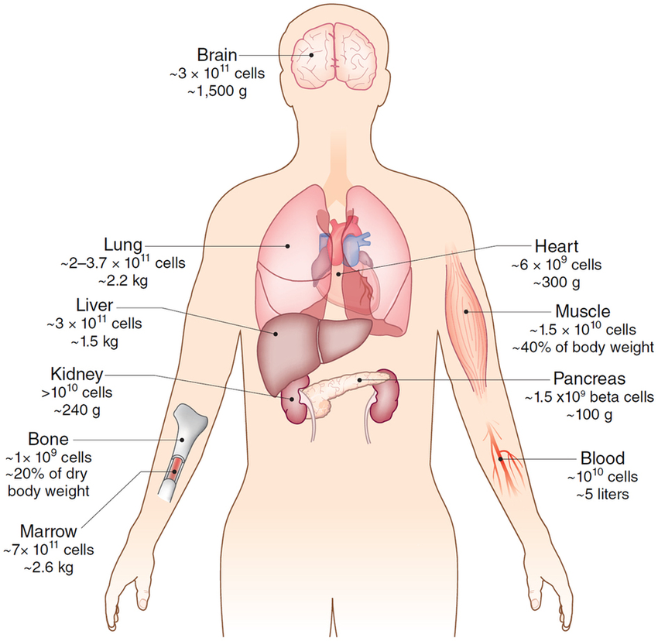
Our bodies contain 37 trillion cells

Slide 7
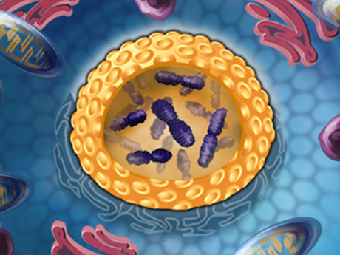
Each cell has DNA = Genes
Chromosomes are big bundles of DNA in our cells which we can see under a microscope
DNA is long strands of information (the recipe) to make you
DNA information is broken down into genes
Each gene specifies how to make a different part of your cells

Slide 8
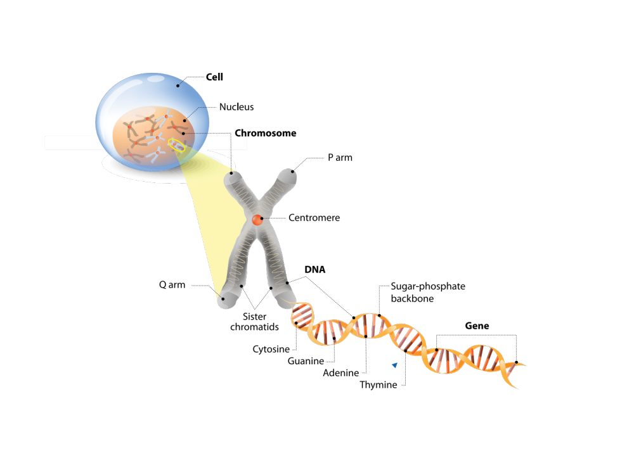
How DNA is packaged in chromosomes:
Each chromosome contains a single, VERY long thread of DNA
a GENE is a section of DNA

Slide 9
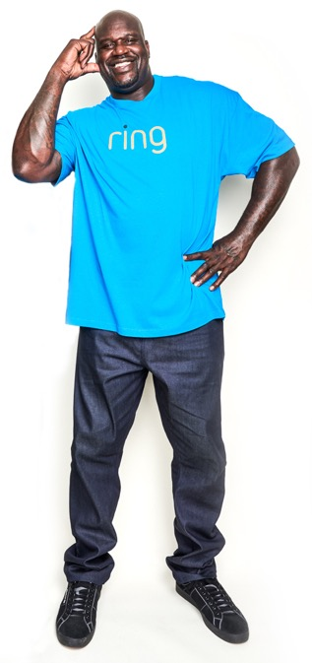
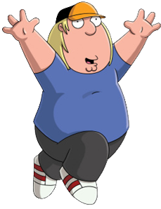

One cell has 2.5 m of DNA!!!
2.5 m
2.16m m
1.78 m
1.64 m
1.63 m
1.53 m

Slide 10
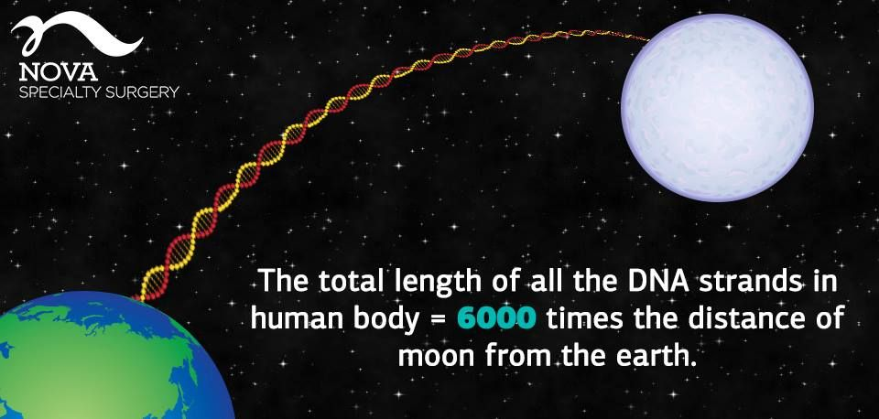

Slide 11
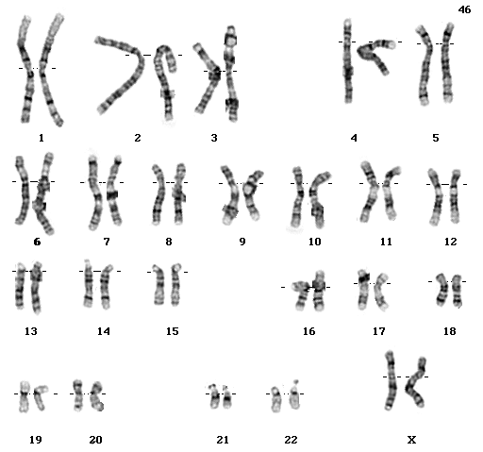
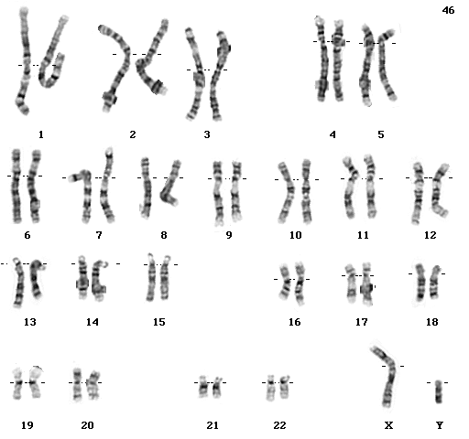
Humans have 46 chromosomes (23 pairs)
female
male
sperm =
egg =
X , Y
X , X

Slide 12
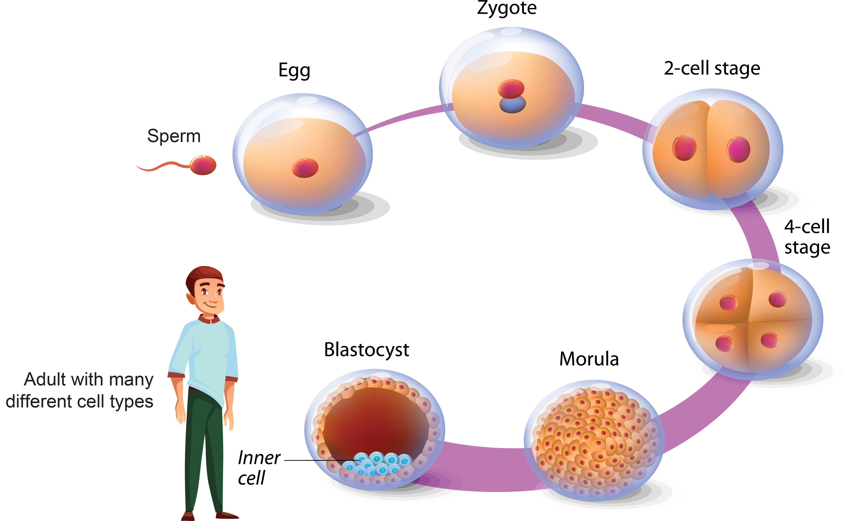
23 chromosomes from the egg and 23 from the sperm combine to make a human

Slide 13
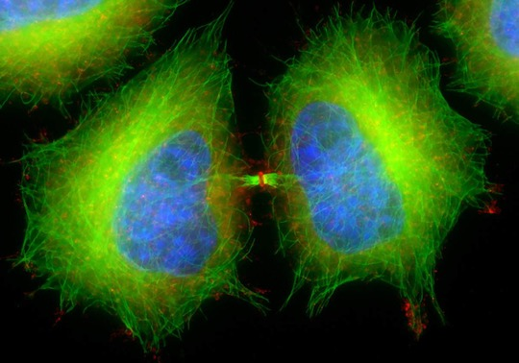
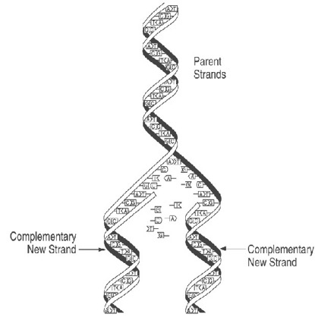
To do this, cells need to divide…
…and DNA needs to replicate – this can lead to mistakes (or mutations) in genes

Slide 14
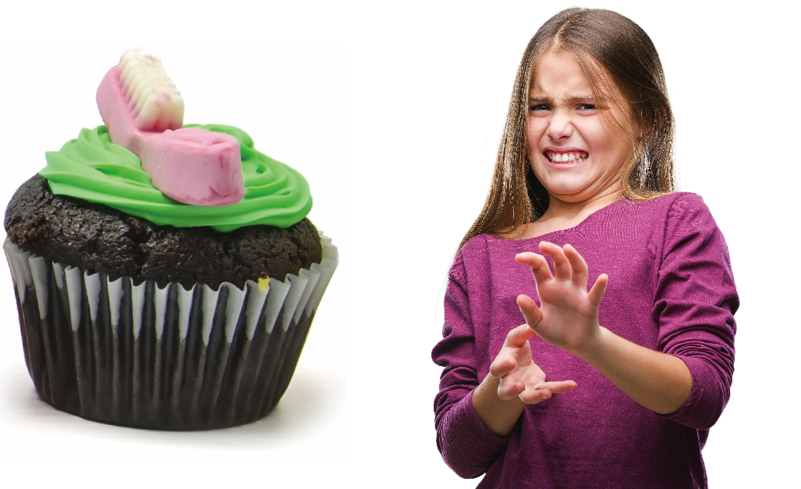
What if a cupcake recipe was wrong & we put salt instead of sugar in our cupcakes?

Slide 15
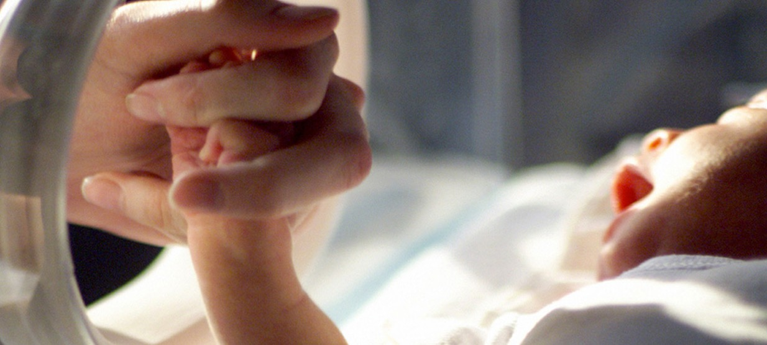
Our bodies are the same.
If our gene recipe is changed (mutated), we can have a birth defect or genetic disease

Slide 16
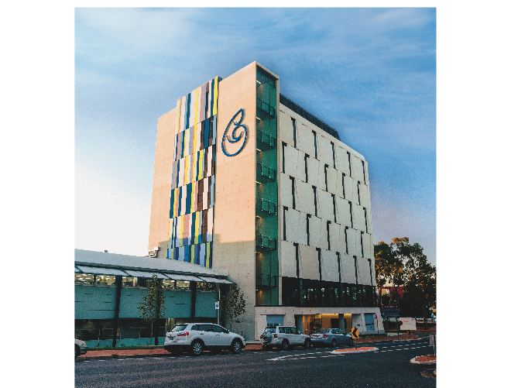
This is why
Children’s Medical Research Institute exists
We do research to understand:
  genes,
  what can go wrong with them,
  and how to fix it!

Slide 17
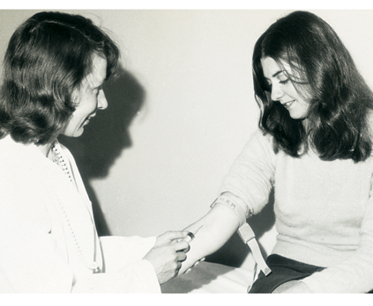
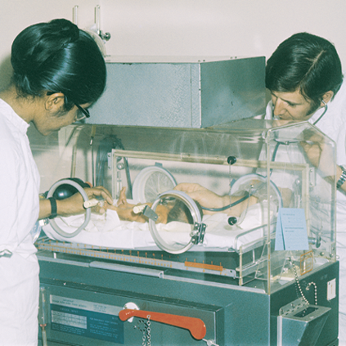
Children’s Medical Research Institute
Children’s Medical Research Institute is 60 years old!
Our scientists created the rubella vaccine to prevent birth defects
They even invented incubators to help babies born prematurely

Slide 18
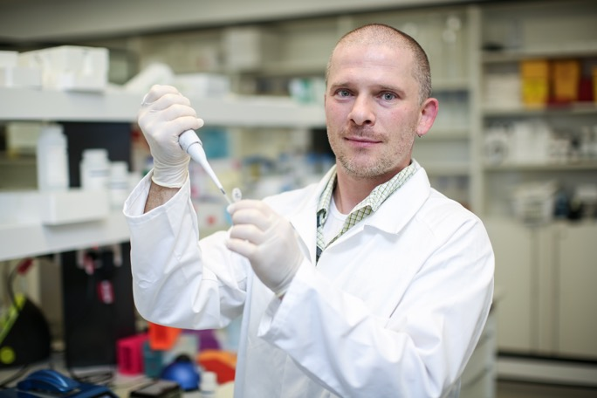
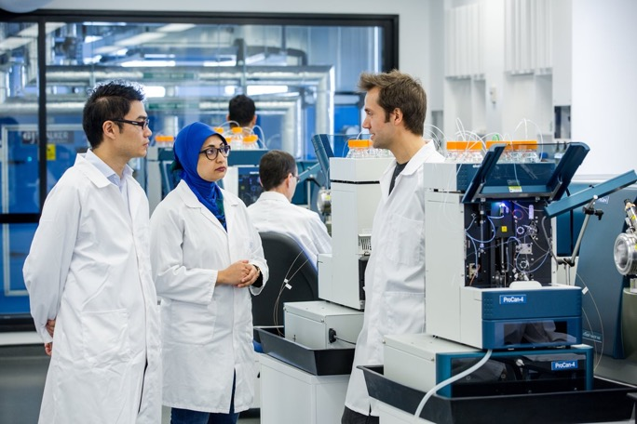
Children’s Medical Research Institute
Nowadays our scientists are finding cures for children’s genetic diseases—like cancer and cystic fibrosis

Slide 19
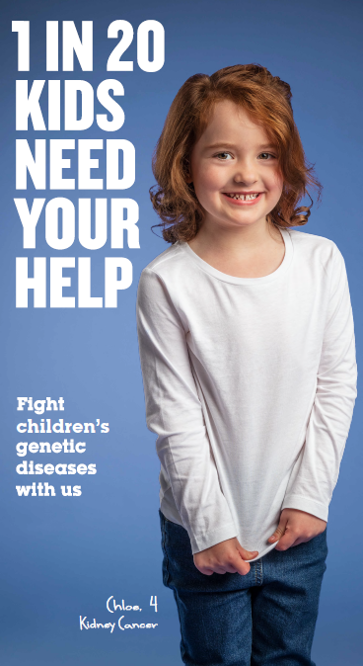
This is Chloe. She’s 4.
Changes in her genes caused her to get Kidney Cancer when she was a baby.
Thanks to medicine developed by scientists and administered by doctors, she got better.

Slide 20
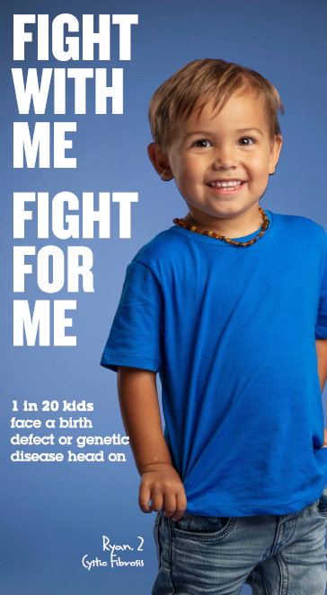
This is Ryan. He’s only 2.
A very small change in one of Ryan’s genes caused him to have Cystic Fibrosis.
It makes it hard for him to breathe, and he has to go to hospital a lot.
He will have this genetic disease all of his life, unless scientists can find a cure.

Slide 21
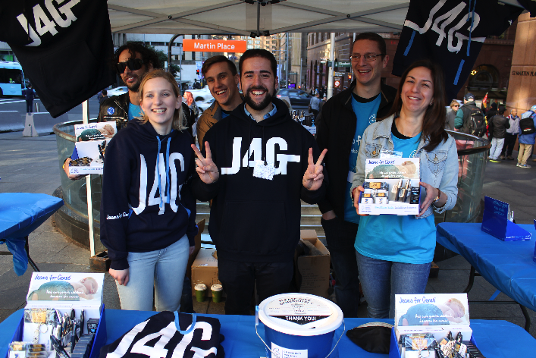
What does Jeans for Genes do?
Jeans for Genes was created to help Children’s Medical Research Institute raise money so find new treatments and cures for kids like Ryan and Chloe.
We believe kids should have a chance to just be kids!
Here are some of our scientists who are working on cures when not raising money

Slide 22
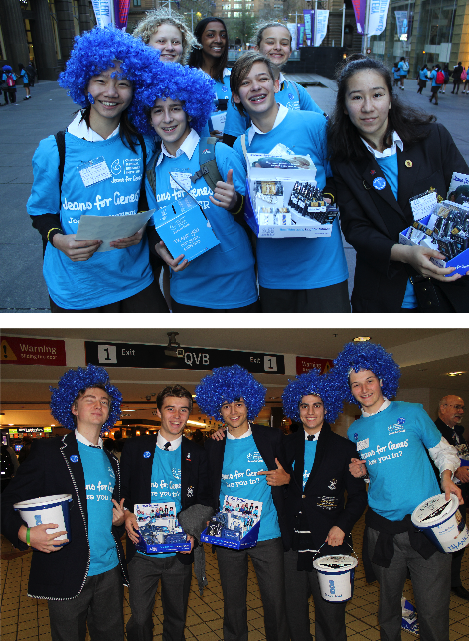
What your school can do to help
Sign up at jeansforgenes.org.au
Hold a denim mufti day, movie night, or blue cupcake sale to raise money.
It doesn’t have to be in August—you can help any time!
Send in the money so our researchers can start finding cures!
Send your photos too. We love seeing happy students learning about genes and helping kids in need.
Thank you!

