Slide 1
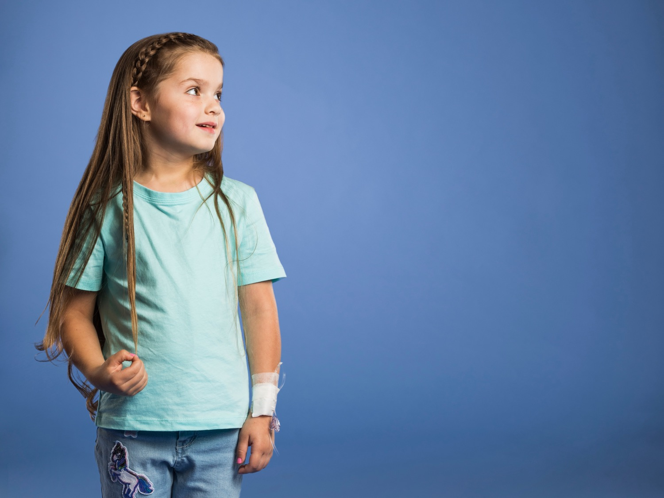

Jeans for Genes
K-2 Presentation

Slide 2

What are ‘genes’?
And why are they important?

Slide 3
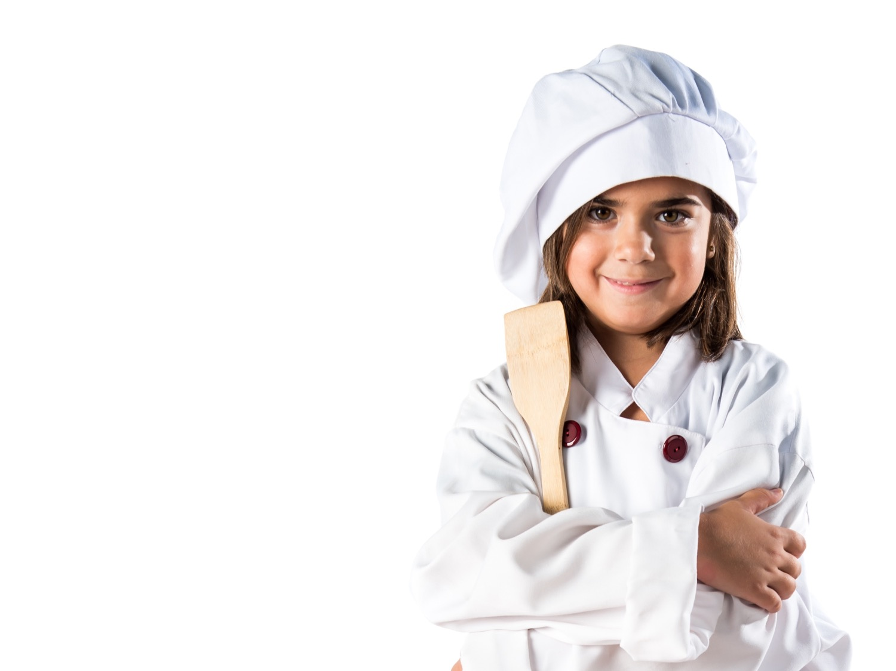
Genes are a recipe for making us!

Slide 4
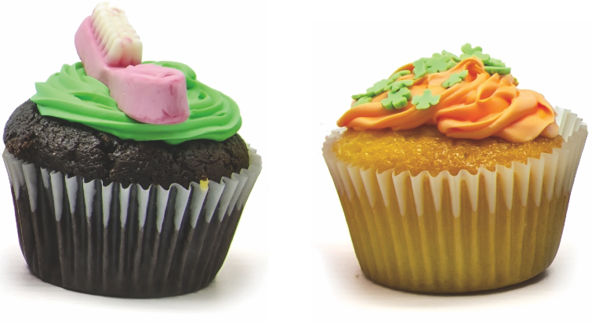
These two cupcakes are similar but slightly different.
Can you see the differences?
They’re different because their recipe is different.

Slide 5
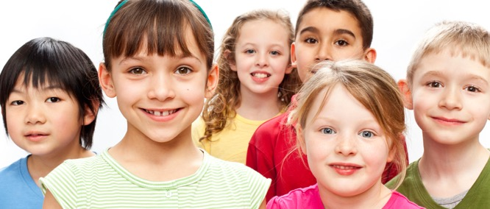
We’re all very similar – but we’re also unique! What are your little differences?

Slide 6
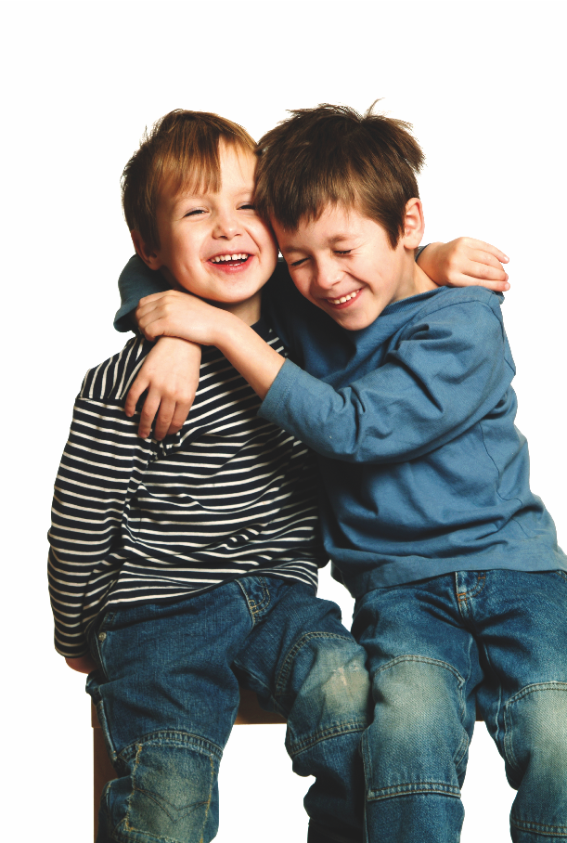
What you look like depends on your recipe—
Your GENES!

Slide 7
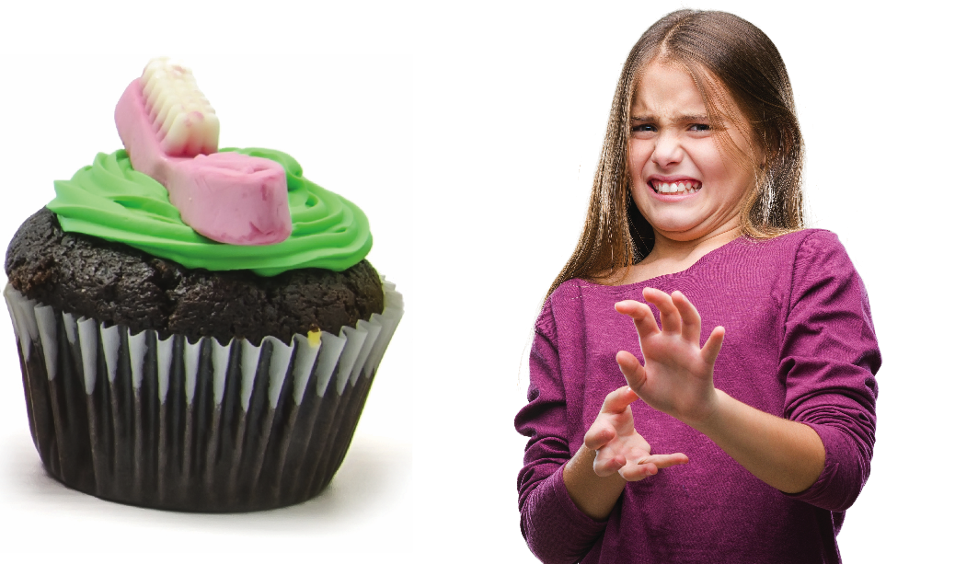
What if the cupcake recipe was wrong & we put salt instead of sugar in our cupcakes?

Slide 8
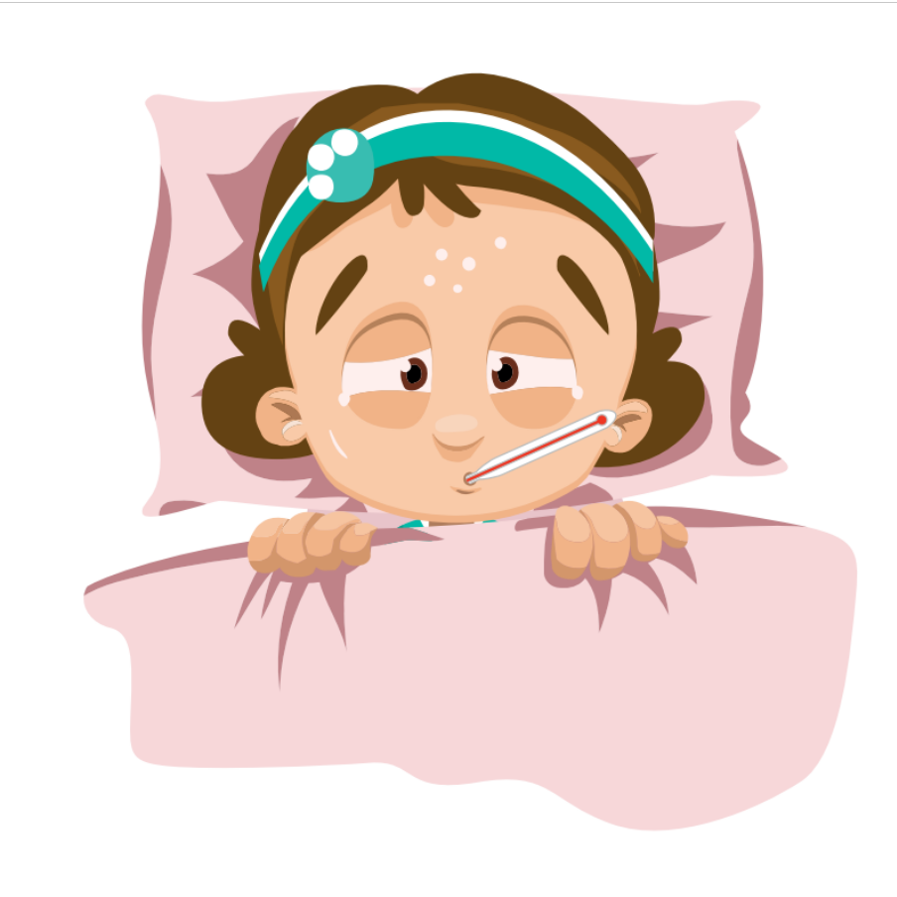
Our bodies are the same.
If our gene recipe changes, sometimes our bodies can become unwell.

Slide 9
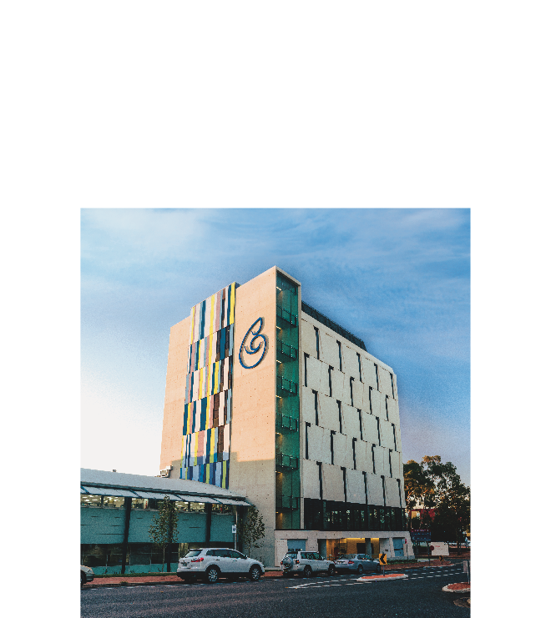
This is why
Children’s Medical Research Institute exists
We do research to understand:
  genes,
  what can go wrong with them,
  and how to fix it!

Slide 10
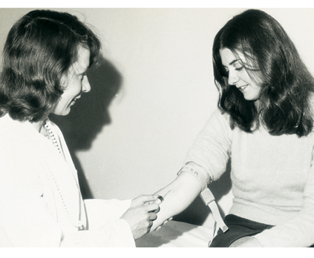
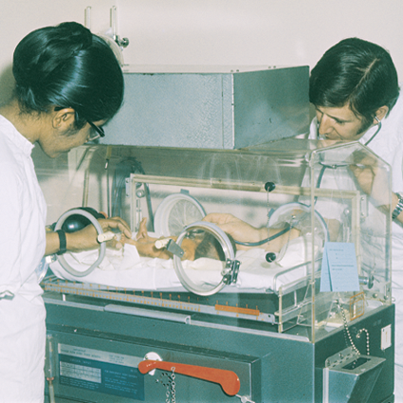
Children’s Medical Research Institute
Children’s Medical Research Institute is 60 years old!
Our scientists created the rubella vaccine to prevent birth defects
They even invented incubators to help babies born too soon!

Slide 11
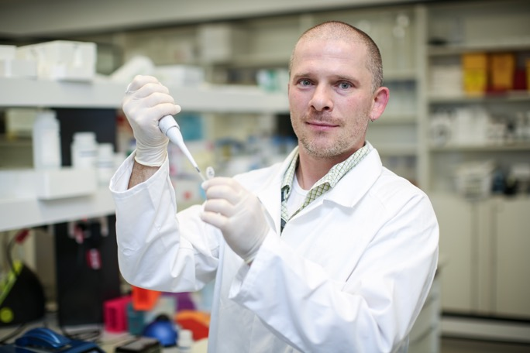
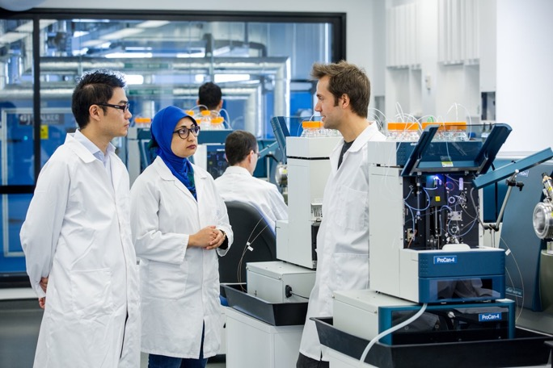
Children’s Medical Research Institute
Nowadays our scientists are finding cures for children’s genetic diseases—like cancer and cystic fibrosis

Slide 12
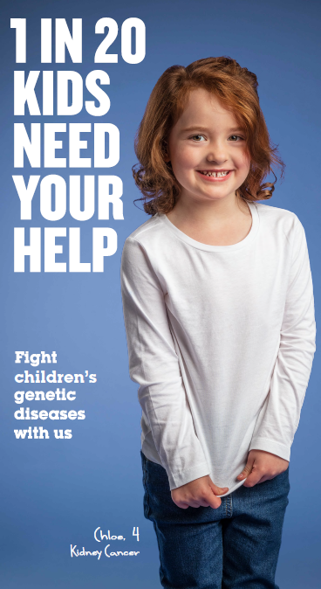
This is Chloe. She’s 4.
Changes in her genes caused her to get Kidney Cancer when she was a baby.
Thanks to medicine developed by scientists and administered by doctors, she got better.

Slide 13
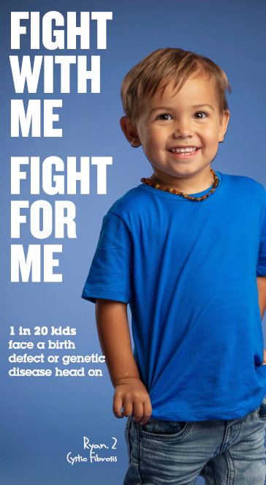
This is Ryan. He’s only 2.
A very small change in one of Ryan’s genes caused him to have Cystic Fibrosis.
It makes it hard for him to breathe, and he has to go to hospital a lot.
He will have this genetic disease all of his life, unless scientists can find a cure.

Slide 14
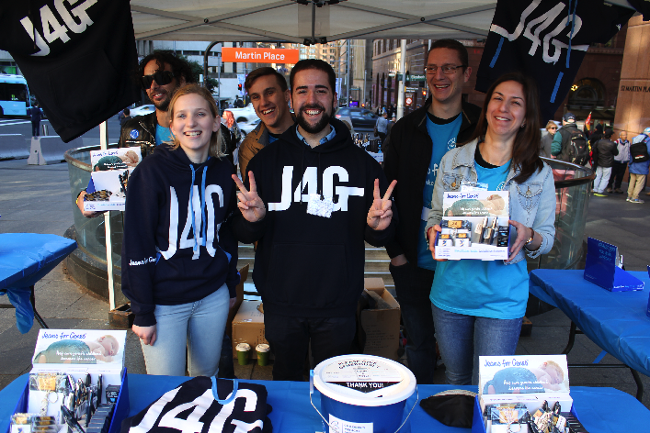
What does Jeans for Genes do?
Jeans for Genes was created to help Children’s Medical Research Institute raise money so find new treatments and cures for kids like Ryan and Chloe.
We believe kids should have a chance to just be kids!
Here are some of our scientists who are working on cures!

Slide 15
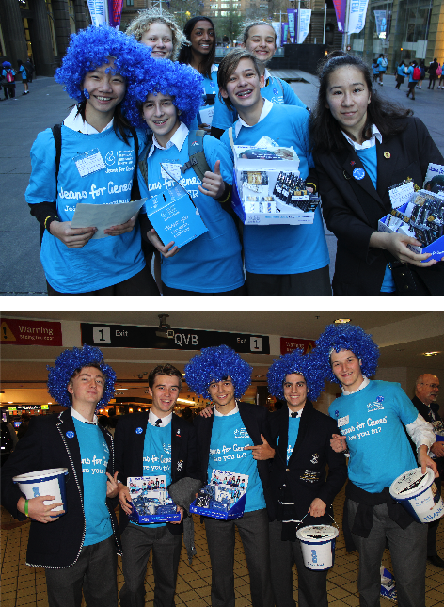
What you & your school can do to help
Sign up at jeansforgenes.org.au
Hold a denim mufti day, movie night, or blue cupcake sale to raise money.
It doesn’t have to be in August—you can help any time!
Send in the money so our researchers can start finding cures!
Send your photos too. We love seeing happy kids learning about genes and helping other kids in need.
Thank you!

